Slide 1


Slide 2

Notes:
We began an important new chapter in Rotary’s history in 2018: We launched our Action Plan, a strategic guide to help us become more effective in everything we do and more effective in telling our stories.
At every level of Rotary, people have embraced the opportunities the Action Plan offers us to meet new challenges and stay relevant for new generations.
I’m here today to give you a progress report on the Action Plan and the work that’s underway for each of the plan’s priorities:
• Increase our impact
• Expand our reach
• Enhance participant engagement
• Increase our ability to adapt
What I’m about to tell you shows that we don’t have to do everything at once. We’re setting achievable goals, monitoring our progress, and making adjustments as we go. You’ll find plenty of inspiration, encouragement, and direction to keep the Action Plan momentum going.

Slide 3

Working together to develop practices and tools for measuring and sharing Rotary’s positive, long-term change
Using our resources for programs that have the potential for the greatest impact
Applying lessons learned through our polio eradication efforts to how we approach other partnerships
Implementing Programs of Scale to provides us with a new framework for thinking about how we bring about change in the world
Notes:
Rotary staff and members at all levels are working together to develop practices and tools for measuring and sharing Rotary’s positive, long-term change. And we’re measuring our impact more deliberately because we know that current and potential partners, program participants, and, increasingly, donors want to see clear, tangible proof of our impact — especially for our humanitarian projects.
We want to ensure that we’re using our resources for programs that have the potential for the greatest impact and that align with our Action Plan or organizational strategy. Every club and district, along with all of their members and participants, can significantly increase their impact by increasing their focus. We’re developing an evaluation process that will help us make objective recommendations about what we should continue doing, start doing, or stop doing.
We’re implementing Programs of Scale, a grant model that was developed to provide measurable and sustainable solutions to issues that affect many people in a large geographic area. Programs of Scale also provides us with a new framework for thinking about how we bring about change in the world.

Slide 4

Identify a project you can use to explore and practice measurement.
Connect with other clubs.
Apply similar Programs of Scale principles to your own projects and grants.
Notes:
This work is underway. Check the Action Plan page at rotary.org/actionplan for resources and news. But also remember that the best way to learn is by doing. Identify a project you can use to explore and practice measurement.
I will support you in focusing your efforts by reviewing your activities and determining which ones can be streamlined or eliminated so your club can spend more time on making a bigger and more lasting impact. I encourage you to connect with other clubs that are also engaged in assessment to get a sense of collective effort.
There’s a Programs of Scale page at rotary.org/programsofscale that has resources that can help you find new ways to develop service projects. I also encourage you to apply similar principles to your own projects and grants.

Slide 5

Embracing and exemplifying diversity, equity, and inclusion (DEI) in everything we do at Rotary
Exploring new products and participant models so that people can join us and take action, no matter where they live
Notes:
We’re committed to embracing and exemplifying diversity, equity, and inclusion (DEI) in everything we do at Rotary. We have revised our DEI statement, which now reflects our stronger-than-ever commitment to being an organization that values, respects, and welcomes everyone who interacts with us. Now we’re developing a comprehensive plan of action with achievable, measurable, and meaningful DEI outcomes for Rotary.
I strongly encourage you to read and follow Rotary’s new DEI Code of Conduct, which points the way to creating more just, open, and welcoming communities or all people.
We’re piloting and evaluating new products and participant models so that people can join us and take action, no matter where they live. We also see great potential in existing programs, including Rotary Action Groups, Rotary Community Corps, Rotary Fellowships, and others.

Slide 6

Visit our DEI page at rotary.org/dei to learn more about how to make your club more inclusive.
Tell us how you’re engaging people beyond traditional membership on the My Rotary Action Plan page.
Notes:
You should visit our DEI page at rotary.org/dei to learn more about how to make their club more inclusive.
We’re eager to hear about the ways you’re engaging people beyond traditional membership. I invite you to share those ideas through the My Rotary Action Plan page.

Slide 7

Making participants central to what we do, which means we’re being proactive, asking people how they want to engage with us
Looking at ways to measure member engagement and satisfaction
Notes:
We’re tearing down the walls between “us” and “them” and thinking about “participants” — a word that encompasses all Rotary members and others who get involved in Rotary activities, like family members, partners, and alumni. And we’re making participants central to what we do, which means we’re being proactive, asking people how they want to engage with us, and making sure they know that we value their participation.
We’re looking at ways to measure member engagement and satisfaction so we can better understand what people are getting from Rotary. We know that when our members don’t find their experiences to be personally or professionally relevant, they go elsewhere. The information we collect will assist clubs, districts, and Rotary International in determining how we can deliver greater value and give people more reasons to stay in Rotary.

Slide 8

Survey your members to learn what’s important to them in their club experience and how they want to grow and develop through Rotary.
Notes:
Start surveying members to learn what’s important to them in their club experience and how they want to grow and develop through Rotary. And make it clear that you’re ready to listen: Be proactive in asking members if they feel engaged enough and listened to and if Rotary is meeting their expectations.

Slide 9

Improving our operations to become more agile and more responsive
Notes:
We’re improving our operations to become more agile and more responsive. We’re using change management strategies throughout Rotary, from the Secretariat to the club level. Governance models, committee structures, business processes — we’re reviewing everything.
Having fewer administrative layers will address the disconnects between clubs, districts, zones, and headquarters. And it will give us a clearer picture of support and resources you need to stay ahead of change.

Slide 10
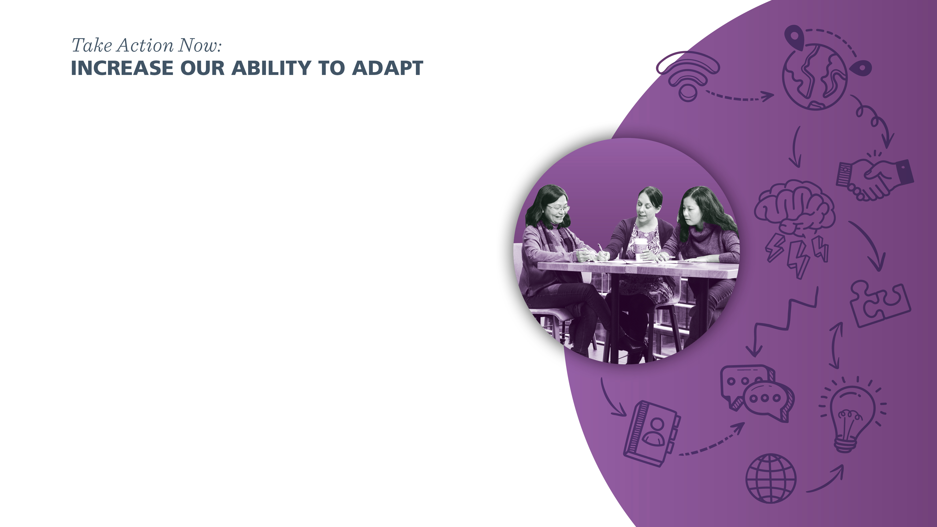
Consider small changes you can make to improve how your club operates.
Notes:
Change is coming. We’ll all be encouraged to do things differently. But new approaches to our organizing principles won’t threaten our sense of who we are. Together, we can get Rotary ready for another century of service.

Slide 11


