Slide 1


Rotary District 9999
Dave McKissock – District Governor 2024-2025
Impact 3 – May 2024

Slide 2
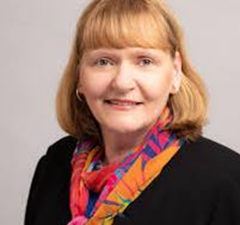
RI President – Stephanie Urchick
2024- 2025 Goals
Rotary Theme “The Magic of Rotary”
Stephanie Urchick urges members to champion Rotary’ Action Plan, find a balance between continuity and change, and work for peace.
Continue with Empowering Women and Girls
Continue with Mental Health awareness
Plant 4 new clubs - 100 new Rotarians in our District
Create Positive Peace in the World

Slide 3

2024 – 2025
“The Year of Change”
District Strategic Plan – Aligned to Rotary International Priorities
District Teams – Action Plans to assist clubs with Growing Rotary, Youth Engagement, Public Image,
Implementation of the Regionalisation Pilot - Regional Council and Portfolio’s
Community Leaders – Community Groupings – Growth Plans
Regionalisation Specialists – Clubs able to access expert advice and support.
District Weekend of Connections – Collaborating and networking – High Impact

Slide 4
District 9999 – Goals
Fun – Make Rotary a FUN experience. Make it irresistible for current members to be engaged and for the community to join. Review club meeting format?? Is it engaging and interactive?, has it variety?, does it suit the clubs style?, would your club be attractive to the community.
Be Innovative and ADAPTABLE towards membership – increase membership by 5%. Look at other styles of membership.
Be Project Visible – Be seen, Be infectious, BE IRRESISTABLE
Foster COLLABORATION with your community clubs and clubs wider afield – INCREASE OUR REACH

Slide 5
District 9999 – Goals
Adopt a partnerships outside Rotary – EXPAND OUR REACH. Establish partnerships with other Service Organisations and also with Business/ Corporate identities. Let’s better CONNECT with our wider community.
YOUTH Development. This is our future, (Interact, RYLA, RYE). District funding has been set aside for the further development in our Youth Programmes. ( RANZ, RYE, RYLA, Rotaract).
INCREASE Foundation contributions / Polio Plus giving.
Create a FUN experience for all, Be INCLUSIVE.

Slide 6

Rotary International
Priorities

Slide 7
District 9999
“Looking to the Future”
FUN ENGAGE – INCLUSIVENESS – DIVERSTY – EQUITY
COLLABORATION SHARE – TEAMWORK – RESOURCES - IMPACT
CONNECTION EXPAND OUR REACH – EXTEND OUR NETWORK
CHANGE REVIEW – ADAPT – BECOME IRRESISTABLE
“INSPIRE YOUR CLUB TO BE A ROTARY CHAMPION OF CHANGE”

