Slide 1
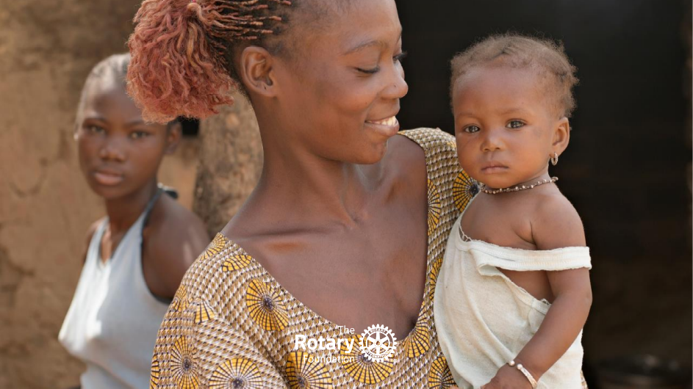

Supporting our
Rotary Foundation
Notes:
<number>

Slide 2
Rotary Club Constitutions
The purposes of a Rotary Club are to:
- pursue the objects of Rotary
- carry out successful service projects based on the five Avenues of Service
- contribute to the advancement of Rotary by strengthening membership
- support the Rotary Foundation
- develop leaders beyond the Club level
Notes:
<number>

Slide 3
Rotary Foundation Mission
To enable Rotarians to advance world understanding, goodwill, and peace through the improvement of health, the support of education, and the alleviation of poverty
Notes:
<number>

Slide 4

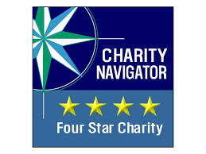






Highest Rated Charity
Rated in the top 10 in the world
Financial
Management
World Fund
Match
Strict reporting processed in place
DDF matched 100%
Rotarian
Engagement
Sustainability
Planning and technical support
Delivering long term community outcomes
Community
Assessment
Low
Administration
Projects based on NEED, not perception
9% for Administration and Fundraising cost

Slide 5
Programmes of the Rotary Foundation
Polio Plus
Grants – District & Global grants, Disaster grants and Programmes of Scale
Peace Fellowships
Notes:
<number>
<number>

Slide 6


Slide 7
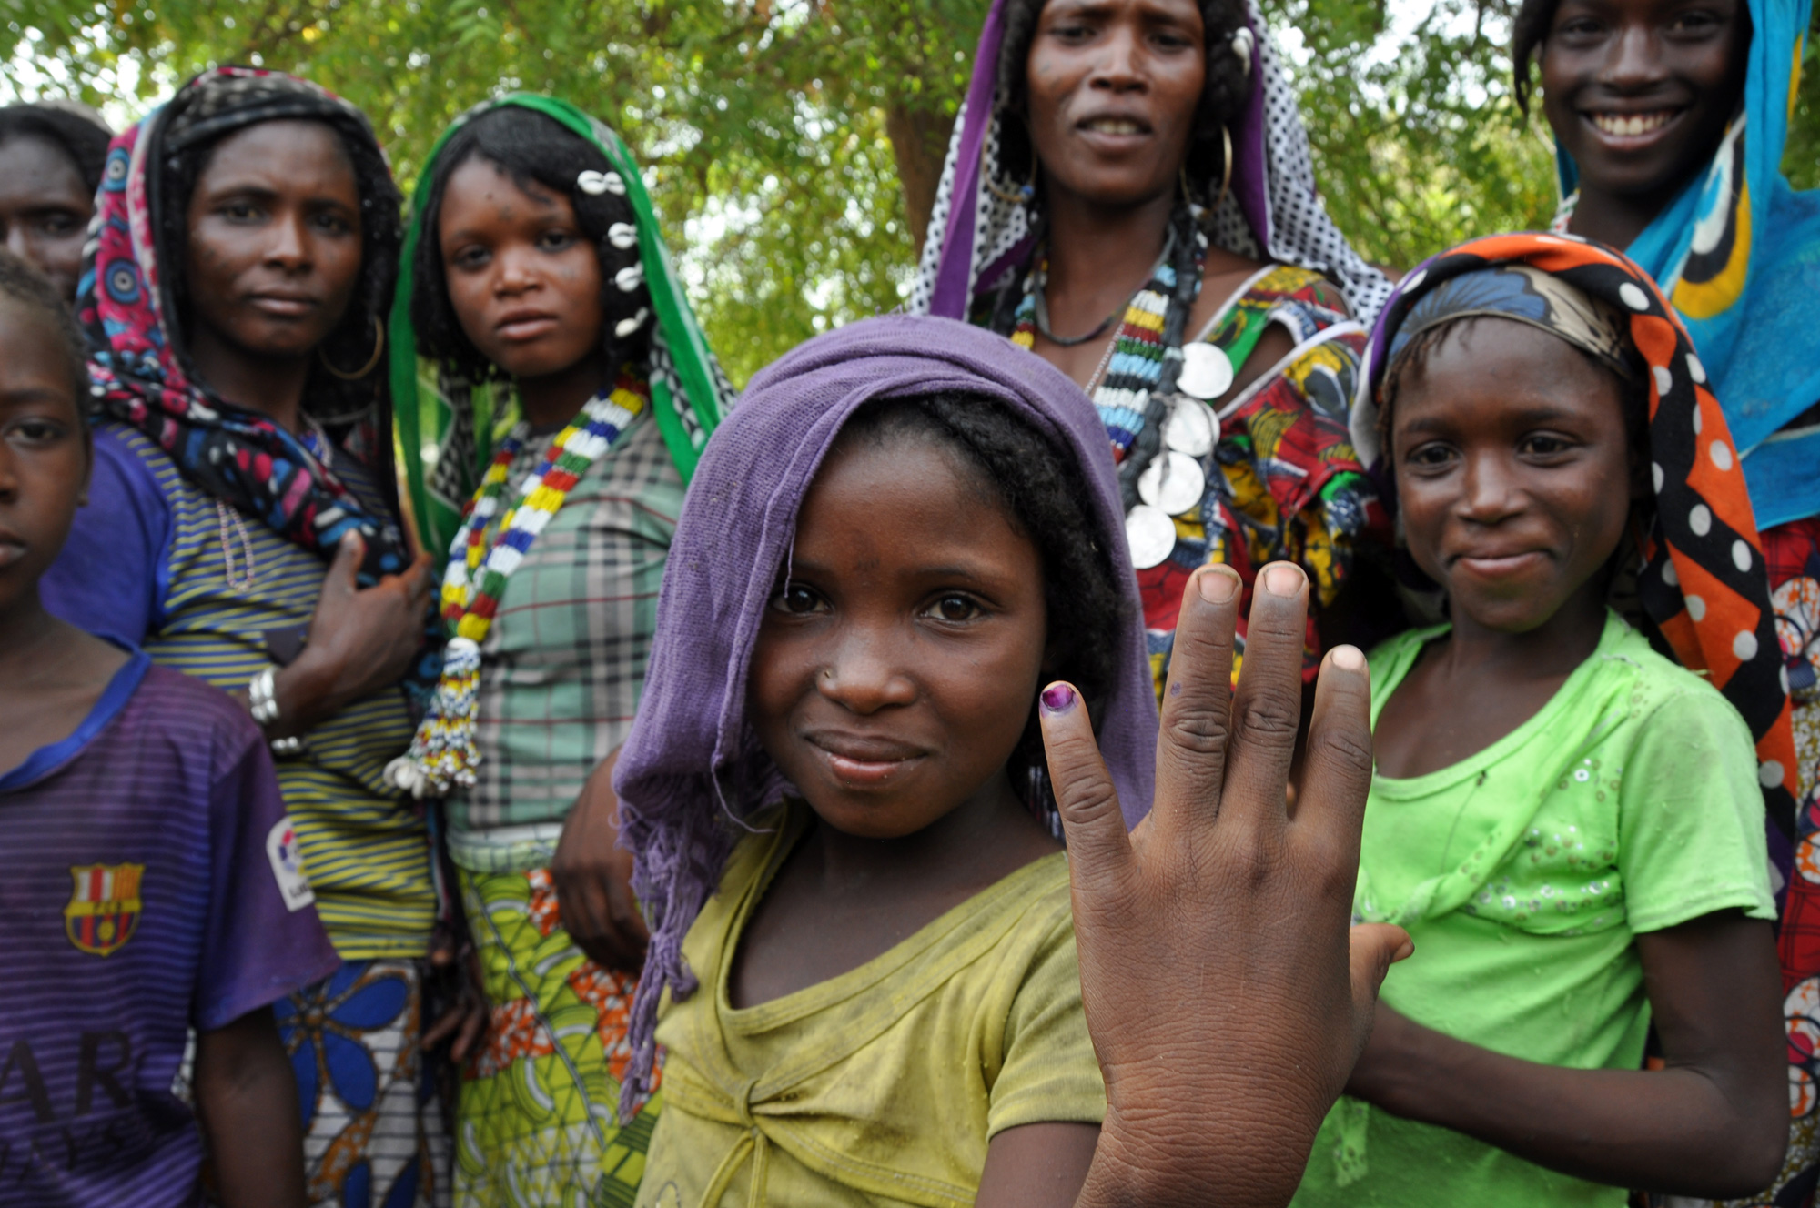
Polio Plus - the Rotary Foundation’s top strategic priority
Polio cases have been reduced by 99.9%
Only two endemic countries remain – Pakistan and Afghanistan
In 2023 there were twelve cases of wild poliovirus
Afghanistan - 6, 3 in 2024, last on April 5th
Pakistan - 6, 2 in 2024, last on Feb 29th
Notes:
<number>
<number>

Slide 8
Polio Plus – so why do we still
need to raise money?
GPEI 2022-26 Strategy requires US$4.8bn
Ongoing surveillance required – Polio is still only a plane ride away – & there’s also vaccine derived disease
Gates Foundation still matches up to US$50m funds raised by Rotarians
Notes:
<number>
<number>

Slide 9
<number>
ROTARY DISTRICT 9999
GUIDELINES FOR DISTRICT GRANTS
2024 – 25 ROTARY YEAR
Notes:
<number>

Slide 10
<number>
Districts grants how they work
Districts may use up to 50% of available DDF for District Grants
Available DDF is a function of giving in the third previous year
In D9999, funding will be allocated to Clubs in line with funds raised by D9970 and D9980 respectively in the relevant year
Funds will be allocated separately until the year 2025-26, when the available funds will have been raised by D9999
A cross-District project such as Richmond RC’s Days for Girls can access funds from both District pools
Notes:
<number>
Richmond Rotary mutli-club gross $19,5000 value : had support directly from clubs in both former districts and the District agreed to allocate $3000 from each pool to make up the maximum $6,000 match share

Slide 11
District Grants – how they work
<number>
District Grants fund small-scale, short-term activities addressing needs in our communities and communities abroad – 20 grants in 2023-24 .
Districts apply for a single consolidated application to TRF for each Rotary year.
Each District chooses which activities it will fund with these grants.
Projects / activities can include:
- Humanitarian & environmental projecta – tree planting, park upgrades, mental health support, community health projects
- Scholarships for any level, length of time, location, or area of study
- Youth programs, including RYE, RYLA, Rotaract, and Interact
- Vocational training teams
Notes:
<number>

Slide 12
Districts grants how they work
<number>
Clubs apply for a grant as either:
Maximum DDF Total Project
match at $ - $ Value
A single club: $3,000 $ 6,000 or more
Multi – Club : $6,000 $12,000 or more
Lead club responsible for all financial management, progress and final reporting
Foundation Committee has discretion to grant more under certain circumstances
Notes:
<number>

Slide 13
Districts grants - must do’s
<number>
Projects have to align with the mission of the Foundation - clearly identify the Area of Focus
Application must clearly show project total costs and how it will be funded; make sure other clubs and 3rd parties have confirmed their funding commitment
Clearly set out how Rotarians will be involved
If the project is for something that will require on-going funding identify how that will be sustained
Club must have an account separate for that used for club operations to manage the grant funding;
Club must maintain an audit trail of all expenditure and project deliverables
Plan for and set out how you will use the project to promote Rotary
Notes:
<number>

Slide 14
Districts grants - some tips
<number>
Tip 1 - Give generously to The Rotary Foundation
  the more we give the more we can achieve
Tip 2 - Start planning your project early
  get quotes etc now to build your budget & plan; build partnerships and collaborate with others clubs now
Tip 3 - Be Bold and Innovative
  Try something new it helps energise your club from just doing the routine things year to year
Tip 4 - Involve Rotarians in the project
  Really important that we don’t just pass $$s to others – Rotarians need to be seen and enjoy delivering projects; it may also help attract new members.
Notes:
<number>

Slide 15
Districts grants - Key Dates
<number>
1 | Clubs attend training then sign and submit MOU - Record kept on data base | Know How meeting May 26th 2024
2 | Any required follow-up materials sent to Clubs – MOUs, application forms etc | Late May/early June
3 | Applications from clubs received, checked by District Grant Chair and Committee | 30 June
4 | District Foundation Committee reviews all applications and determine allocations Advises District’s decisions to clubs | By 28 July
5 | District Foundation Chair submits District Grant spending plan to TRF for approval | By 18 August
6 | Once TRF approval received, final decisions advised to Clubs and published through District Newsletter Clubs advise details of accounts to pay grant to if it is not already on file | Expected no later than mid – September
7 | Money in clubs accounts by | September 30th approx
Notes:
<number>

Slide 16
<number>
CLUB QUALIFICATION MEMORANDUM OF UNDERSTANDING 2023-24 Rotary Year
- Mandatory for Clubs wishing to access TRF funds
- Sets out qualification steps and obligations
- Club officer responsibilities
- Financial Management Plan
- Bank Account requirements
- Reporting requirements
- Document retention
- Reporting mis-use of funds
- Club authorisation and agreement (to abide by MOU)
Notes:
<number>

Slide 17
Global Grants
Area of focus
Community need
Community participation
Strengthen knowledge, skills, resources
Long-term benefit
Measurable results
US$30,000 minimum budget
Notes:
<number>

Slide 18
Global Grants process
Club qualifies – signs MOU
Club completes first step of application
Club submits second step of application
District approves application online
Rotary Foundation reviews for approval
Notes:
<number>

Slide 19
D9999 Global Grants in progress
GG2233954 - This is a vocational training and small business capacity-building project which will benefit vulnerable rural women and youth in Tanzania.
GG2125311 - This project addresses the need for upgraded and expanded WASH access for patients and health care workers
at rural health centers in Zomba district, Malawi, specifically at Namasalima Health Centre.
Notes:
<number>

Slide 20
Rotary Peace Fellowships
- Each year, The Rotary Foundation awards up to 50 fellowships for master’s degrees and up to 40 for certificate studies at premier universities.
- Peace Fellows are selected in a globally competitive process based on academic and professional achievements
- Over 1,600 program alumni are now working in more than 140 countries as leaders in national governments, nongovernmental organizations, education and research, law enforcement, business and consulting, human rights law, media and the arts,
Notes:
<number>

Slide 21
Club Foundation Engagement Plan
Foundation Committee
  Club Foundation Chair
    Club Polio Chair
    Club Personal Giving Chair
2. Commit a portion of Clubs Fundraising to The Rotary Foundation - Commitment notes will
be sent to all Clubs in October/November each year
  Annual Fund – $125/member/year
  Polio Fund – $25/member/year
3. Members to become personally engaged supporters
  Centurions – $100/year
  Paul Harris Society
  Benefactors (Bequest Society)
4. Explore opportunities for District and Global Grants
  Attend Grants Seminar
5. Use “Rotary Club Central” as your Clubs Foundation Management tool
  Submit and monitor your goals in “Rotary Club Central”
Notes:
<number>

Slide 22
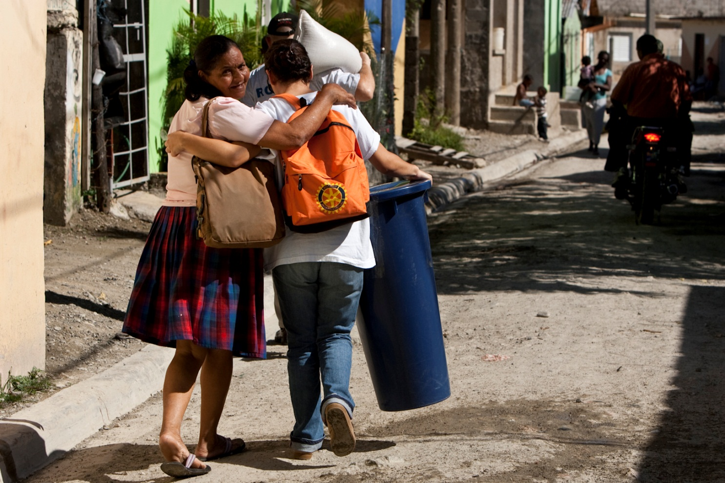

Thank you for your attention!
Notes:
<number>
<number>

Slide 23
Rotary Peace Fellowships
- Each year, The Rotary Foundation awards up to 50 fellowships for master’s degrees and up to 40 for certificate studies at premier universities.
- Peace Fellows are selected in a globally competitive process based on academic and professional achievements
- Over 1,600 program alumni are now working in more than 140 countries as leaders in national governments, nongovernmental organizations, education and research, law enforcement, business and consulting, human rights law, media and the arts,
Notes:
<number>

Slide 24

PolioPlus Fund
TRF
Programs
District Grants
DDF
(District
Designated
Fund)
Annual Fund
SHARE
Global Grants
Rotarian
Contributions -
Clubs
And
Individuals
Peace Scholars
Endowment Fund
Investment
Earnings
World
Fund
POS Grants
Disaster Response Fund
Disaster Response Grants
Notes:
Districts grants are managed by districts who can set there own priorities for grants; minimums and maximums – easiest grant to get
Global: multi- district multi-country grants: minimum projects value $USD 30 to $400k to Maximum
<number>

